Slide 1
LinkedIn Freshers
Product Strategy
Product Owner: Debdeep Bandyopadhyay
© 2019 Udacity. All rights reserved.

Slide 2
Background
Why Are We Here?
When people hear about professional networking sites, the first thought in their minds is LinkedIn
However LinkedIn caters well for experienced professionals with knowledge about their skillset, interests and preferences, something which puts recent graduates and to-be graduates into a fix
LinkedIn: New Grads is here to change the status quo
© 2019 Udacity. All rights reserved.

Slide 3
Business Case
© 2019 Udacity. All rights reserved.
Notes:
[ALL PARTICIPATION]

Slide 4

Initial Focus
Where are we starting?
We will focus on the Indian market for now
Reasons are
Second largest market for LinkedIn (64M+ or ~10%)¹
High market growth rate @3.8% QOQ²
Highest graduate growth rate @2.35% YOY³
<2% revenue for >10% LinkedIn’s consumer base⁴
© 2019 Udacity. All rights reserved.
Notes:
https://news.linkedin.com/about-us#statistics
https://datareportal.com/reports/digital-2019-global-digital-overview
https://monitor.icef.com/2019/07/oecd-number-of-degree-holders-worldwide-will-reach-300-million-by-2030/
https://economictimes.indiatimes.com/markets/stocks/earnings/linkedin-india-net-rises-26-in-fy18/articleshow/66408262.cms?from=mdr

Slide 5
Opportunity
What’s the problem?
Customer churn by competitive products like naukri.com, amcat, elitmus
Less engagement for recent graduates
TAM = Number of new grads in India/year¹ * Monthly subscription price² * 12
= 20M * $20 * 12 = $4.8B @2.35% growth rate YOY
© 2019 Udacity. All rights reserved.
Notes:
1.https://monitor.icef.com/2019/07/oecd-number-of-degree-holders-worldwide-will-reach-300-million-by-2030/
2.https://www.linkedin.com/premium/products/
3.https://economictimes.indiatimes.com/markets/stocks/earnings/linkedin-india-net-rises-26-in-fy18/articleshow/66408262.cms?from=mdr

Slide 6




Proposal
What’s Our Solution?
Skill and career enhancement programs
Mentor guidance and meaningful engagement
AI based Mock Interviewer
AI powered Resume Builder
© 2019 Udacity. All rights reserved.

Slide 7

Return On Investment
What can we do?
Assuming 10% of Number of new grads in India/year subscribes, the revenue would be $488M.
Marketing + Product Development + Other costs = $100M (say)
ROI = Profit/Costs ~ 388%
© 2019 Udacity. All rights reserved.
Notes:
https://economictimes.indiatimes.com/markets/stocks/earnings/linkedin-india-net-rises-26-in-fy18/articleshow/66408262.cms?from=mdr
https://www.investopedia.com/articles/basics/10/guide-to-calculating-roi.asp

Slide 8
Measurement
How will we know if we’re successful?
Business KPIs:
Conversion to subscription ~2%
Product KPIs:
Average time to first job application ~2 days
Average time to first job landing ~1 month
Quality KPIs:
Play Store rating increase ~4.5/5
Recommendation quality (evaluated via timely surveys) ~4.5/5
Sentiment analysis of Play Store comments
Development KPIs:
Outages/day reduced by 50% to < 10⁵
© 2019 Udacity. All rights reserved.

Slide 9
Competitors
© 2019 Udacity. All rights reserved.
Notes:
[ALL PARTICIPATION]

Slide 10
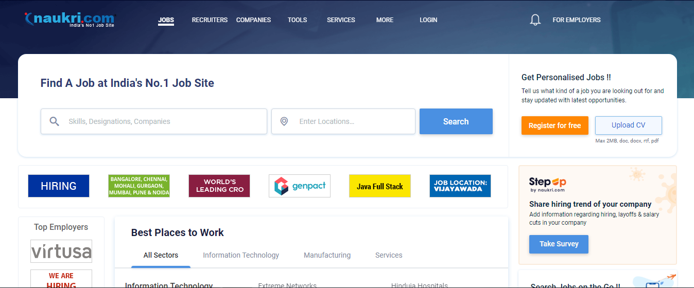
Type 1 - Companies similar to LinkedIn
E.G. Naukri.com
A job portal site similar to linkedin with main focus on startups, mid tier companies and service based companies.
A strong employee referral system is at place.
A good portion of revenue of about $65M comes from corporates and has a good presence of HRs and recruiters on the platform.
© 2019 Udacity. All rights reserved.

Slide 11
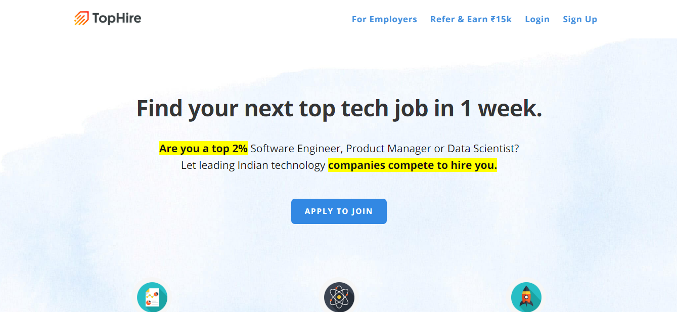
Competitor 2
E.G. Tophire
A growing startup focuses mainly on upskilling the job seekers and college passout and paving the way for them to land into their dream job
Make use of AI systems to build resumes, focus on interview etc.
Not having much penetration in market considering they are a medium scale business with less than 160 employees.
Fees charged are generally upfront or on the basis of income share agreement and is much more compared with linkedin premium services and generates a total revenue of around $10M
© 2019 Udacity. All rights reserved.

Slide 12



Our Advantages
Why are we better?
Diverse and talented employees
Ability to build ones professional network
Huge database of company and employees
© 2019 Udacity. All rights reserved.

Slide 13
Roadmap and Vision
© 2019 Udacity. All rights reserved.
Notes:
[ALL PARTICIPATION]

Slide 14
Roadmap Pillars
Where do we go from here?
VISION : Hasslefree career and opputunity platform for new graduates.
Roadmap themes
Personalized Products
Recommendation
Career enhancement Program.
© 2019 Udacity. All rights reserved.

Slide 15
Personalized Products
Addressing customer needs
 | Q1 | Q2 | Q3 | Q4
Core functionality | Resume builder based on forms. | Chatbot for automated resume builder | AI Interviewer for grooming candidates for interview process
Extras |  | Added customizable designs for resume. |  | AI based group discussions.
© 2019 Udacity. All rights reserved.

Slide 16
Smart Recommendations
Suggestions based on customer skills and preferences
 | Q1 | Q2 | Q3 | Q4
Core functionality | Recommendation System for jobs and connections |  | Recommedation system for career path based learning through linkedin learning.
Extras |  | Recommendation system for post and contents. |  | Enhancements
© 2019 Udacity. All rights reserved.

Slide 17
Career enhancement program
Bridge the gap between you and your dream.
 | Q1 | Q2 | Q3 | Q4
Core functionality | Suggesting courses and certification in linkedin to enhance profile | Career path suggestions for new grads | Mentor recommendation based on career path and goals | 1-on-1 interaction with companies based on interest
Extras |  | Improvement and suggestions based on mock interviews
© 2019 Udacity. All rights reserved.

Slide 18
Where do we go from here?
Widening the scope
Future plan includes:
Online career fair and counselling.
College and Academic collaboration for student profile development based on Industry requirements
Video platform for motivational videos, interview experiences at different companies, career topics etc.
© 2019 Udacity. All rights reserved.

